Slide 1
San Bernardino County Transportation Authority
Direct Mail Campaign
VVTA – Barstow
MBTA – 29 Palms and Yucca Valley
Mountain Transit – Crestline and Big Bear
NAT - Needles

Slide 4


Slide 5
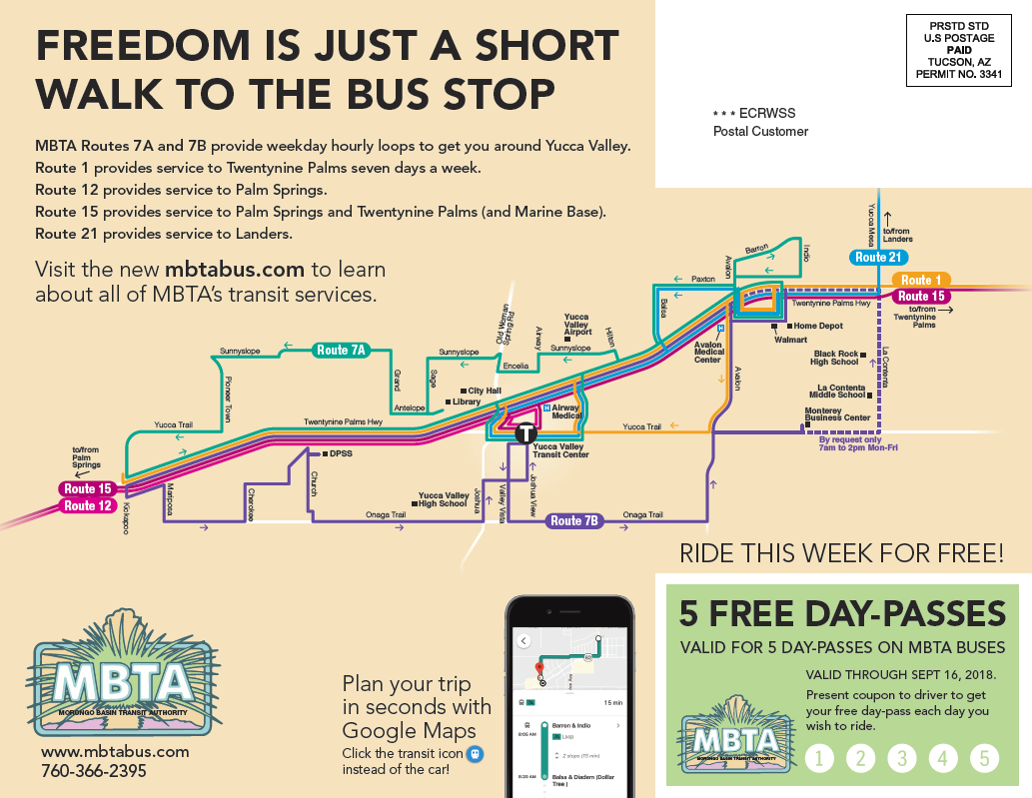

Slide 6


Slide 7
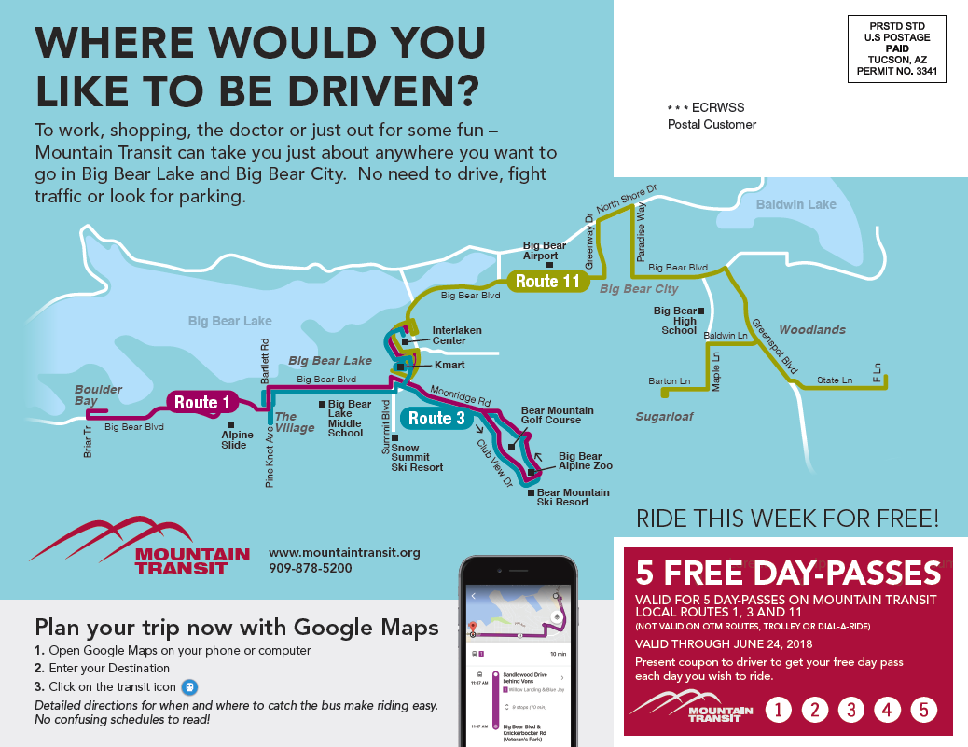

Slide 8


Slide 9
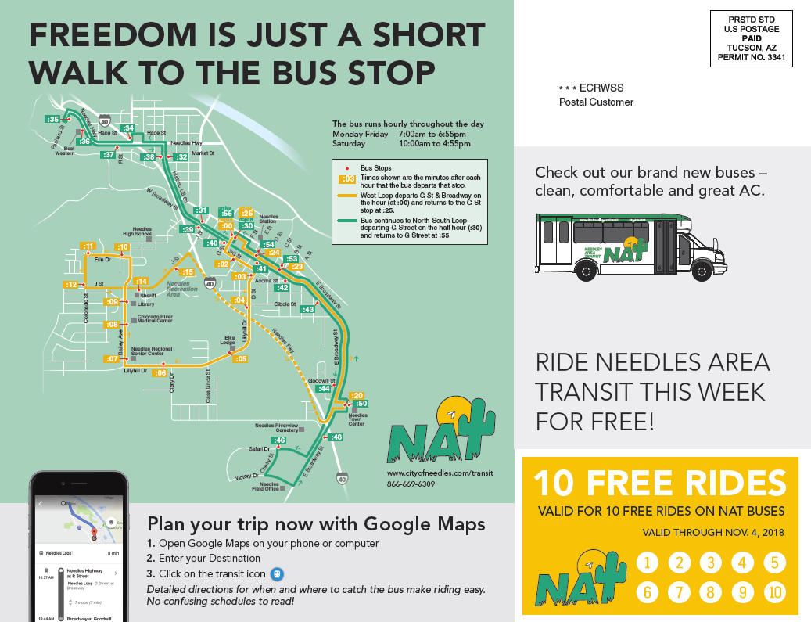

Slide 10



Newspaper & Online Ad Support

